Slide 1
Landmarked Sprint 4 Status Report
By Logan Francisco, Junmin Yee,
Garrett Hammock, and Kelly VanMeter

Slide 2
Continued Algorithm Implementation
Focused on next stage of algorithm
Checking Line of Sight
Finding a point in the direction of phone

Slide 3
Edge Cases in Algorithms
Looking straight up/down
Inside caves
On top of cliff looking down
On summit of mountain
Underwater
Looking into water
In the sky(plane, skydiving, paragliding)

Slide 4
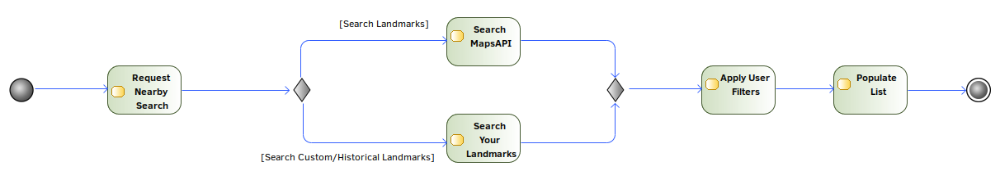
Landmark Retrieval Activity Diagram

Slide 5
Landmark Retrieval
Need relevant results
I.e. Applebee’s is not a “Landmark”
Need to limit results in scope
Collaboration with Junmin’s Algorithm
Limited results returned by MapBox API
Working with few resources

Slide 6
Relevant Landmark Results
“Applebee’s is not a Landmark”
At least, not for the primary objective of our application
First, a Reverse Geocode Search
Translates GPS coordinates to an approximate location. E.g. “Klamath Falls” or “Hollywood”
Working with a multitude of loosely-defined “categories” to limit results. Limit to “Points of Interest” opposed to “Cities”, but what are POI?
Second, a Forward Geocode Search
Composed of Location Data, Category Information, Scope Information
Need to work on incorporating these sensibly into GUI

Slide 7
Limit Results in Scope
Current implementation:
Come up with an approximate “Proximity Point” to bias results around
End Goal: Limit results to area the user is facing
Filters the results returned through Junmin’s Algorithm
Hard limit results to within scope of where the user is facing
Need to come up with exact boundary points
Translate the “Vision Triangle” into one or more boundary boxes parallel to latitude/longitude lines to represent the user’s line of sight

Slide 8
Limited Results Returned
Reverse Geocoding
5 result return limit
Forward Geocoding
10 result return limit

Slide 9
Custom Landmarks
Created structure for implementation
Attached notes and photos in database

Slide 10
Cloud Storage
Connecting to Azure SQL Server
JDBC Driver Connection

Slide 11
Local storage
Need to store our data persistently till it can be uploaded to the cloud
Our users won’t always have internet connections
Some users might never have internet connections
We need to store landmark data retrieved by the user in a local database

Slide 12
Local storage
We do this with with SQLite
Implemented with Room Persistence library
Local db resides in our app’s private storage
Our data structure is compact
High volume of landmarks can be stored locally
Users with internet access can choose to delete local landmarks

Slide 13
Room Persistence Library
Automates a lot of the boilerplate code that is required to do basic SQL operations in SQLite
Guarantees validity of queries at compile time
No guarantee that the data will be correct
But, guaranteed that the queries are valid before the user ever runs our app

Slide 14
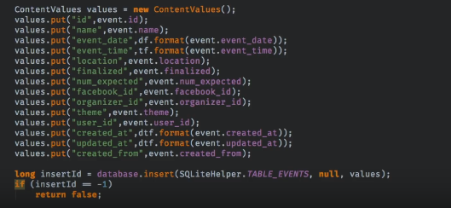

Slide 15
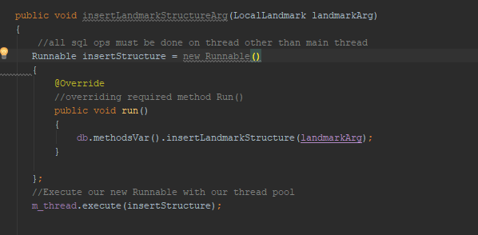

Slide 16
Need for multi-threading
SQLite operations cannot be run on main thread
Main thread used for GUI, running additional operations on it will cause UI lag and crashes
Java offers several solutions to this problem. However, not all of them are suitable for our needs
For example, if we just create two new threads and run an insert and select simultaneously, which finishes first?
We need to be able to control the order of the sql operations being run

Slide 17
Thread pool
Thread pools create threads and delegate execution of incoming tasks on free pool threads
By using a single thread for all SQL operations, we can guarantee that they will run in the order they are called.
We implement 4 local DB’s, we can implement four individual single thread pools .
Right now a single thread works, but thread pools are very scalable
Single thread pools operate in the same way as larger thread pools
We can increase the size of the pool and not modify any other code

Slide 18
UI
Implementing pictures is more difficult than anticipated
Pictures from online vs one on a user’s phone
XML is absolute(mostly)
Dynamic creation of elements can crash the app
But can dynamically set almost anything (listeners, layout parameters from other objects, pictures)
Although can overload certain UI classes perfectly fine
Mostly used for tying landmark data to an element

Slide 19
UI (cont.)
MediaWiki
Laid the groundwork to start implementing MediaWiki
Allow us to display information about retrieved landmarks
Custom Landmarks
Made preparations for having the user enter in their own notes
Already made a class to allow sending landmarks to other activities

Slide 20
DEMO TIME

